Slide 1




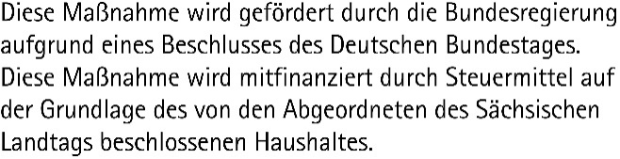
TRAINING: Data Science and AI for Medicine Training School 2026 Day 1: Machine Learning Basics – Theory and Practice
SPEAKER: Matthias Täschner
Using materials from Robert Haase (DSC ScaDS.AI / Leipzig University)
These slides may be reused under the terms of the CC-BY 4.0 license, unless otherwise specified.

Slide 2
AGENDA
Theory and Terms
Areas of Artificial Intelligence (AI)
Paradigms of Machine Learning (ML)
ML Model Training
Theory and Practice
Model Types in ML
Practical Use of ML Libraries in Python

Slide 3
Areas of Artificial Intelligence (AI)
Historical phases of AI
1950
Artificial Intelligence
Programs mimic intelligent human behavior
1980
Programs independently identify connections and patterns in (structured) data
Machine Learning
Digitalization / Data / Hardware
2000
Deep Learning
Use of neural networks with (very) many layers

Slide 4
Areas of Artificial Intelligence (AI)
Specialized (weak/narrow) AI
Application-specific
Trained on labeled data
Adaptation for other applications not possible/difficult
Cannot extrapolate
General (strong) AI
Human-like capabilities
Access to the knowledge of humanity, beyond the individual
Can work creatively and create new solutions for universal tasks
Great for data analysis

Slide 5
Areas of Artificial Intelligence (AI)
Model Family
Paradigms
Supervised
Unsupervised
Reinforcement
Semi-Supervised
Self-Supervised
Problems
Regression
Classification
Clustering
Dimension reduction
Anomaly detection
Sequence-to-sequence
Recommendations
Generative modeling
Time series prediction
...
Areas, paradigms, model families (not exhaustive)
Artificial Intelligence
Machine Learning
Linear Models
Neural Networks
Decision Trees
Deep Learning
Feed-Forward
Kernel-based
Autoencoder
Generative AI
Multi-Layer Perceptron
Clustering
CNN
Transformer
…
RNN
Ensembles
…
…
…

Slide 6
Areas of Artificial Intelligence (AI) Applications
Regression: Prediction of a continuous (numerical) value
Classification: Prediction of a discrete label/class/category
Clustering: Grouping of data points based on their properties
Dimensionality Reduction: Compression of high-dimensional data to a few informative dimensions
Anomaly Detection: Detection of data points that deviate from the “normal” pattern
Sequence-to-Sequence: Converting one ordered sequence of data points into another
Recommendations: Ranking data according to relevance or predicting user ratings
Generative Modeling: Learning data distribution and using it to generate new, synthetic data

Slide 7

Paradigms of Machine Learning (ML) Supervised Learning
Procedure
ML models are trained using pre-labeled data
Input data and the desired target values are provided for training
Prediction of target values on new, previously unknown data of the same format
Application examples
Classification, regression
Anomaly detection
Generative modeling
Algorithms / Model types - Examples
Linear Regression
Decision Trees & Random Forest (DT & RF)
Support Vector Machines (SVM)
Artificial Neural Networks (ANN/NN)
Data
Trained ML-Model
=
=
= ?
Label
Unknown Data

Slide 8
Paradigms of Machine Learning (ML) Un-Supervised Learning
Procedure
ML models are trained with unlabeled data.
Models independently recognize patterns, structures, and correlations.
Application examples
Clustering
Dimensionality Reduction
Anomaly Detection
Algorithms / Model types - Examples
K-Means Clustering
Autoencoder
Data
Trained ML-Model
Unknown Data

Slide 9
Paradigms of Machine Learning (ML) Reinforcement Learning
Procedure
An agent is trained to maximize a certain reward in an environment through its decisions – “trial and error”
Rules define the agent's possible actions
Rewards and punishments influence the agent's behavior
Application examples
Game agents, e.g., in chess or Go
Automation systems, robotics
Simulations
Training process of Large Language Models
Algorithms / Model types - Examples
Q-Learning
Markov Decision Processes (MDP)
Monte Carlo Methods
Environment
Action
Reward
State
Agent

Slide 10
Paradigms of Machine Learning (ML) Linearity: Linear vs. Non-linear Models
Linear model ≠ straight line curve
Linearity refers to model parameters
A model is linear if its prediction is a linear combination of its input features. (e.g., weighted sum of input data)
Linear models
Easy to interpret, based on well-understood principles, fast and efficient training
Can only model simple, linear relationships in the data
Examples: Linear or Logistic Regression, ARIMA, linear SVM, etc.
Non-linear models
Also model complex, non-linear relationships in the data
More difficult to interpret, complex training with more parameters, often more data required
Examples: Decision Tree, kernel-based SVM, k-NN, Neural Networks, etc.

Slide 11
Paradigms of Machine Learning (ML) Probabilistic Models
Trained to learn the (statistical) distribution in the data instead of predicting individual points
Input: Prior knowledge (prior) combined with input data,
Output: Prediction a downstream distribution (posterior), sampling from this distribution
Allows modelling uncertainty/confidence – returns “what” and “how certain”
Examples: Naive Bayes, Bayesian neural networks, etc.

Slide 12
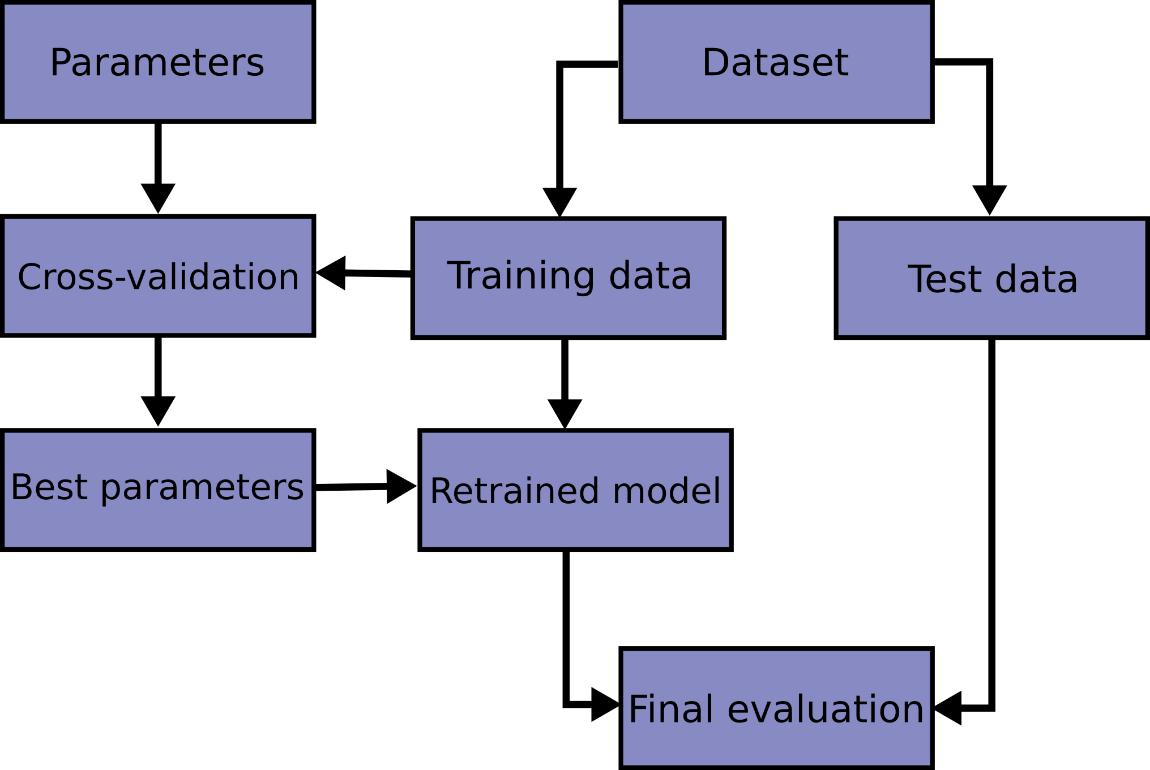
ML Model Training Basic Terms and Concepts
Core steps of ML model training process
Data Preparation
Understand / prepare data (type, scale, missing values, outliers, bias, ...)
Feature engineering (select / create features the model can learn from)
Divide data for training and tests (train-validate-test split)
Model Selection
Get a baseline for comparison
Select the models you want to work with
Model Training with Parameter Tuning
Train model on training data
Tweak model parameters to increase prediction quality
Model Evaluation
Evaluate trained model on test data with on selected metrics
Overall goal: good model generalization (prediction on unseen data)

Slide 13
That’s it for the theory-only part ☺
Next: Mixed theory-practice parts on ML Models and how to use them in Python
Practice
Theory

Slide 14
Types of Machine Learning Models Regression
Theory
“Residual” difference between predicted and observed values
Linear Regression
Models a straight line → y = w∗ x + b
y = Target variable
x = Input Data / Features
w = Regression Weights (slope)
b = Constant (y intersect)
[x and w can also be vectors]
Attempts to minimize the sum of squared residuals (mean squared error)
Prediction of continuous numerical value, assuming linear relationship between features and target
Fast, easy to interpret
Problems with complex, non-linear relationships in the data (e.g., curves)
Extension: Polynomial Regression → y = w₁∗ x + w₂∗ x² + … + w_{d}∗ x^{d} + b
y
Model params
Modeled linear equation for ideal features
x
Metric
y
Better modeled using polynomial regression
x

Slide 15
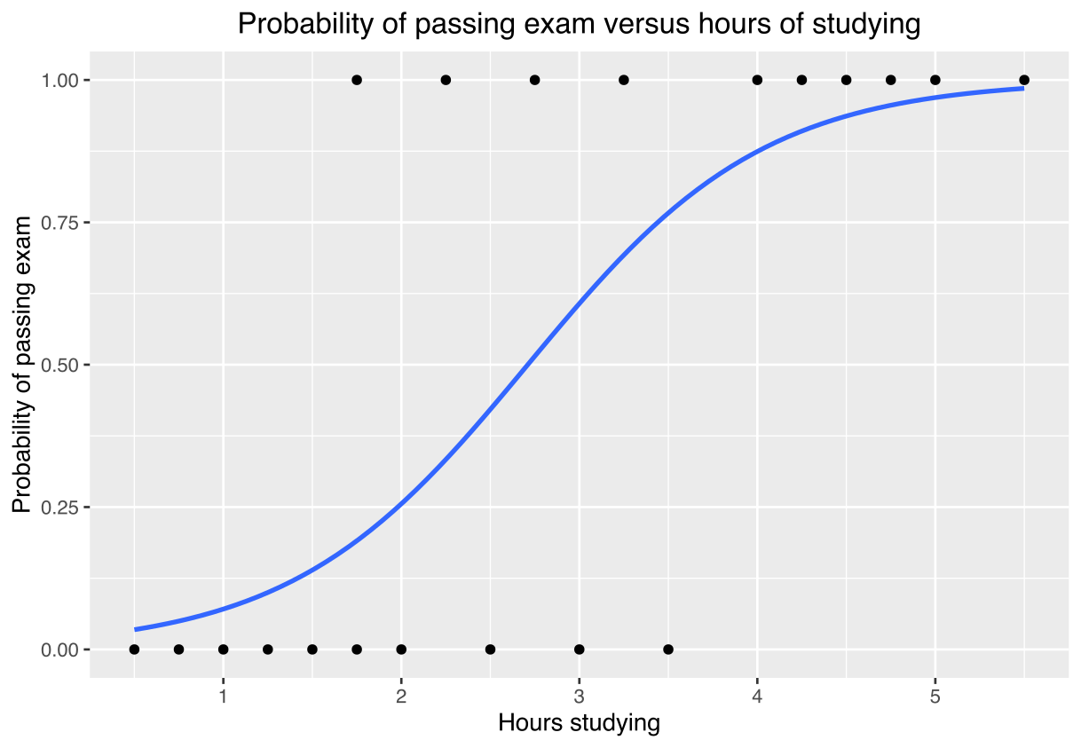
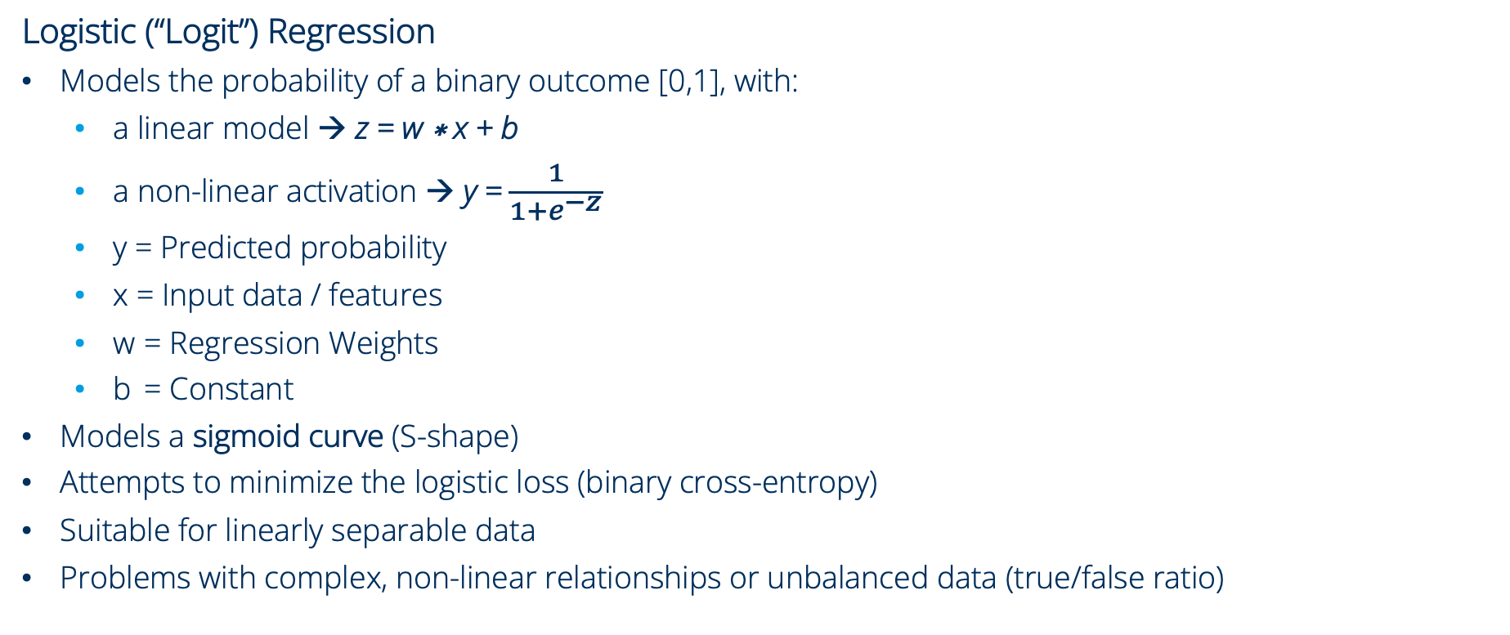
Types of Machine Learning Models Regression
Theory
Logistic (“Logit”) Regression
Models the probability of a binary outcome [0,1], with:
a linear model → z = w ∗ x + b
a non-linear activation → y = $\frac{1}{1+e^{−z}}$
y = Predicted probability
x = Input data / features
w = Regression Weights
b = Constant
Models a sigmoid curve (S-shape)
Attempts to minimize the logistic loss (binary cross-entropy)
Suitable for linearly separable data
Problems with complex, non-linear relationships or unbalanced data (true/false ratio)
Model params
Source: Canley, https://en.wikipedia.org/wiki/Logistic_regression, CC BY-SA 4.0
Metric

Slide 16
Types of Machine Learning Models Regression
Practice
Regression with scikit-learn
Navigate to the training materials folder
Use uv to start JuyperLab
Open the notebook “day1.3_ml-basics/01_regression.ipynb”
We will use the Python package scikit-learn and its modules:
sklearn.datasets: Tools for using common datasets for ML or for generating synthetic data
sklearn.model_selection: Tools for data splitting, parameter tuning, and more
sklearn.linear_model: Collection of linear models for regression and classification
sklearn.metrics: Collection of various metrics for model evaluation

Slide 17
Types of Machine Learning Models Decision Trees
Theory
Decision Tree
Divides the feature space into regions using decision rules learned by optimizing a split criterion
Can be used for regression, classification (Random Forests also for anomaly detection)
Each region is assigned a constant prediction (mean value for regression, majority class for classification)
Can capture non-linear relationships, while remaining interpretable
Model params:
Max depth
Split criterion
Min samples for split
Max leaf nodes
...
x < 50
features for decision rules
split criterion
Depth
x < 25
x < 75
split criterion
…
y = 2
y = 10
y = 5
y = 18
…
Decision tree with greater depth for closer fit to training data. But increases overfitting and reduces generalization.
Piecewise constant approximation of the target
y
y
x
x

Slide 18
Types of Machine Learning Models Decision Trees
Theory
Random Forest
Ensemble Model consisting of n Decision Trees (DT)
Each DT is trained on a randomly resampled dataset (samples may appear multiple times)
Random subset of features considered at each split
Prediction is obtained by averaging (regression) or majority vote (classification)
Reduces variance and overfitting compared to a single DT
y
y
y
x
x
…
x
Decision Tree 1
Decision Tree 2
…
Decision Tree n
Fitting on
resampled dataset
Fitting on
resampled dataset
Fitting on
resampled dataset
Ensemble Prediction
Decision Tree 1
Decision Tree 2
Decision Tree n

Slide 19
Types of Machine Learning Models Decision Trees
Practice
Decision Trees with scikit-learn
Navigate to the training materials folder
Use uv to start JuyperLab
Open the notebook “day1.3_ml-basics/02_random-forest.ipynb”
We will use the Python package scikit-learn and its modules:
sklearn.datasets: Tools for using common datasets for ML or for generating synthetic data
sklearn.model_selection: Tools for data splitting, parameter tuning, and more
sklearn.tree: Collection of decision tree models for regression and classification
sklearn.ensemble: Collection of random forest models for regression and classification
sklearn.metrics: Collection of various metrics for model evaluation

Slide 20

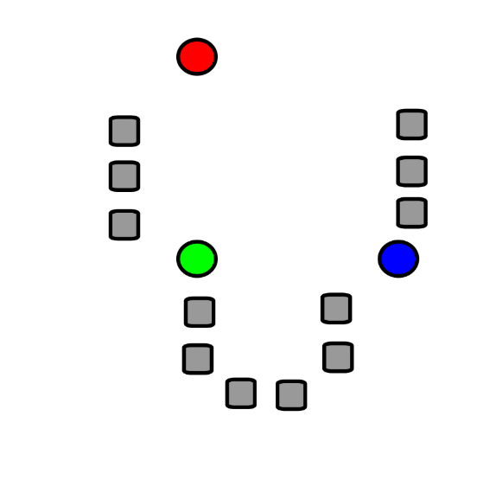
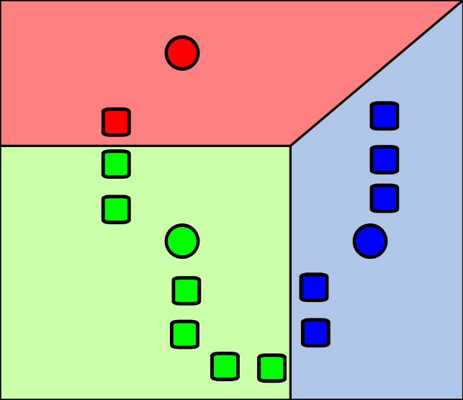
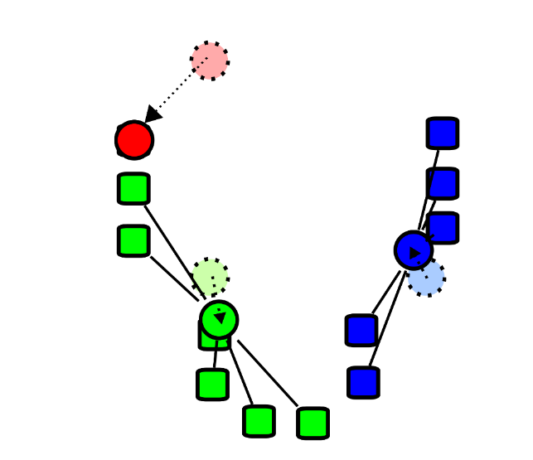
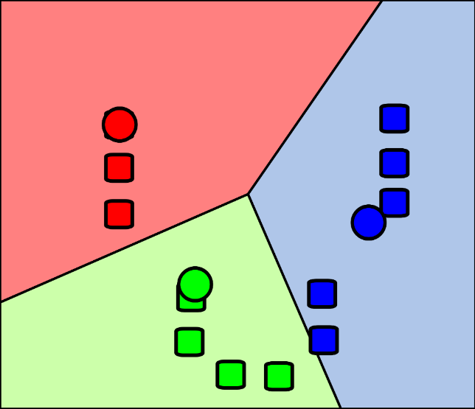
Types of Machine Learning Models Clustering
Theory
k-Means Clustering
Simple and fast clustering algorithm for Euclidean feature spaces
Number of clusters k must be specified
Expected to produce convex clusters of roughly spherical shape
Sensitive to outliers and to feature scaling (reliance on Euclidean distance)
Minimizes the sum of squared distances between points and their assigned cluster center
Source: Chire, https://de.wikipedia.org/wiki/K-Means-Algorithmus, CC BY-SA 4.0
1: Initialization of cluster centers “centroids” (often random)
2: Assignment regions induced by centroids, assign point to nearest center
3: Recompute the centroids as mean of newly assigned points
4: Repeat steps 2 & 3 until convergence or a maximum number of iterations
Source: I, Weston.pace, https://de.wikipedia.org/wiki/K-Means-Algorithmus, CC BY-SA 3.0

Slide 21
Types of Machine Learning Models Clustering
Practice
Clustering with scikit-learn
Navigate to the training materials folder
Use uv to start JuyperLab
Open the notebook “day1.3_ml-basics/03_clustering.ipynb”
We will use the Python package scikit-learn and its modules:
sklearn.datasets: Tools for using common datasets for ML or for generating synthetic data
sklearn.model_selection: Tools for data splitting, parameter tuning, and more
sklearn.cluster: Collection of clustering models
sklearn.metrics: Collection of various metrics for model evaluation

Slide 22
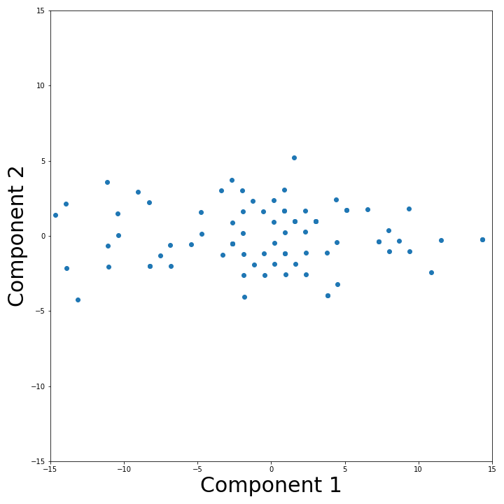
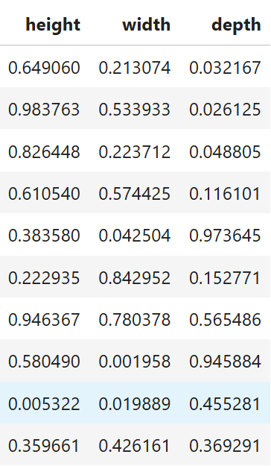
Types of Machine Learning Models Dimension Reduction
Theory
Principal Component Analysis (PCA)
Dimension reduction through a linear, orthogonal transformation of the data
Projects data onto a lower-dimensional space spanned by directions of maximum variance
Principal components are linear combinations of the original features
PCA assumes linear relationship, sensitive to feature scaling, data should be centered and standardized
Alternative approaches, especially for more complex non-linear relationships
t-SNE, UMAP, Autoencoder
PCA(2) creates 2 principal components as linear combinations of height, width, and depth

Slide 23
Types of Machine Learning Models Dimension Reduction
Practice
Dimension Reduction with scikit-learn
Navigate to the training materials folder
Use uv to start JuyperLab
Open the notebook “day1.3_ml-basics/04_dimension.ipynb”
We will use the Python package scikit-learn and its modules:
sklearn.datasets: Tools for using common datasets for ML or for generating synthetic data
sklearn.decomposition: Collection of data transformation and decomposition methods
We will use PCA to visualize the results of clustering high-dimensional data

